Slide 1


Marketing
McGraw-Hill
Higher Education‘s
E-Commerce Portal
University of Pennsylvania Case Competition Team
Amanda Ganske, Melissa Lamb, Diana Zhou, Adela Mou

Slide 2
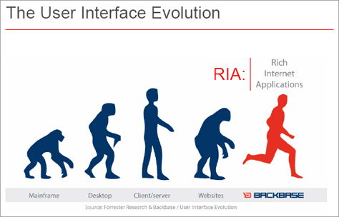
The Case
Evolution is necessary for leadership in a changing market
EXTERNAL SHIFTS
Digitization
Increasing online textbook sales
INTERNAL TRANSFORMATIONS
Value proposition as educational material provider
Product and service offerings
Relationships with students and professors

Slide 3
Agenda
How can McGraw-Hill Higher Education use its e-commerce portal to evolve with a changing market?
Strategy
What portal features will make it the overall destination for educational material for MHHE’s target audience?
Portal
How will MHHE utilize modern marketing techniques to drive traffic and sales to the portal?
IMC

Slide 4

Analysis & Strategy
Marketing the Portal
Developing the Portal
Evolution

Slide 5
Context
SWOT Analysis gives us a better understanding of the problem
 | Positive | Negative
Internal | Strengths Market power Brand equity Existing relationships with professors Customized content | Weaknesses Commoditized product Intermediary status
External | Opportunities Growing demand for higher education Attractiveness of the student market Ebooks Lack of clear leadership in the emerging digital market | Threats Backlash against publishers Slow adoption by gatekeepers Secondary market for textbooks

Slide 6
SWOT Analysis
Leverage MHHE’s Strengths
 | Positive | Negative
Internal | Strengths Market power Brand equity Existing relationships with professors Customized content | Weaknesses Commoditized product Intermediary status
External | Opportunities Growing demand for higher education Attractiveness of the student market Ebooks Lack of clear leadership in the emerging digital market | Threats Backlash against publishers Slow adoption by gatekeepers Secondary market for textbooks

Slide 7
SWOT Analysis
Overcome MHHE’s Weaknesses
 | Positive | Negative
Internal | Strengths Market power Brand equity Existing relationships with professors Customized content | Weaknesses Commoditized product Intermediary status
External | Opportunities Growing demand for higher education Attractiveness of the student market Ebooks Lack of clear leadership in the emerging digital market | Threats Backlash against publishers Slow adoption by gatekeepers Secondary market for textbooks

Slide 8
SWOT Analysis
Seize MHHE’s Opportunities
 | Positive | Negative
Internal | Strengths Market power Brand equity Existing relationships with professors Customized content | Weaknesses Commoditized product Intermediary status
External | Opportunities Growing demand for higher education Attractiveness of the student market Ebooks Lack of clear leadership in the emerging digital market | Threats Backlash against publishers Slow adoption by gatekeepers Secondary market for textbooks

Slide 9
SWOT Analysis
Counter MHHE’s Threats
 | Positive | Negative
Internal | Strengths Market power Brand equity Existing relationships with professors Customized content | Weaknesses Commoditized product Intermediary status
External | Opportunities Growing demand for higher education Attractiveness of the student market Ebooks Lack of clear leadership in the emerging digital market | Threats Backlash against publishers Slow adoption by gatekeepers Secondary market for textbooks

Slide 10
Traditional Distribution
Burning bridges with bookstores is not possible in the near future
Publisher
Portal
Bookstores
Online Booksellers
Students

Slide 11







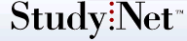


Online Distribution
E-commerce increases competition
SITE TRAFFIC
Student-run sites
PERCEIVED CREDIBILITY

Slide 12
Secondary Market
Selling used texts provides opportunities for increased profits

Slide 13
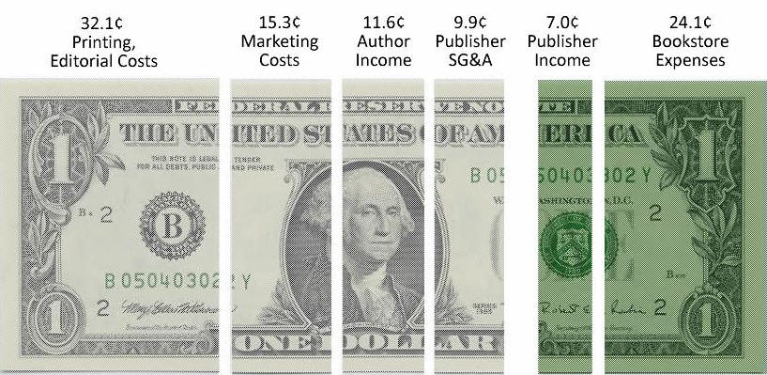
Ebooks
Digitization offer opportunities for higher margins for MHHE
Textbook Revenue Breakdown
Source: National Association of College Stores, 2008.

Slide 14
Professors as Gatekeepers
For students to use the portal, professors must recommend it
Publishers
Professors
Students
Portal

Slide 15
The Missing Link
Connecting both groups will allow MHHE to provide value
Student Interests
Professor Needs
Classroom experience
Learning
Value for educational materials
Teaching Quality
Time for academic &
personal pursuits
Communication
Convenience
Consolidation
Integration
Strategy

Slide 16
Strategy
Be the missing link between students and professors
Establish McGraw-Hill as the leading source of academic content by being the missing link between students and professors by
Creating a direct-to-student distribution channel for educational content and secondary market control
Developing a portal to facilitate interactions between students and professors
Making McGraw-Hill relational instead of transactional

Slide 17
Research Highlights
Primary data show window of opportunity
QUALITATIVE
QUANTITATIVE
Professor Interviews
Student
Focus Groups
Professor Surveys
Student
Surveys
Professor Interviews
Student
Focus Groups
Content and accessibility matter for book selection
MHHE is a favored publisher
Time and tenure matter
Buyer vs. non-buyer behavior
Site design validation
Value-added materials and add-ons desired
Receptive to student needs
Ease of website use matters
Segmentation
Portal features desired
Value of secondary market

Slide 18
Developing the Portal
Marketing the Portal
Evolution
Analysis & Strategy

Slide 19

Textology.com
Brand McGraw-Hill’s e-commerce portal
Name : implies academic content, expertise
Tagline : establishes trust, leverages brand
Graphic : stylized books represent user experience
Color : eye-catching, associated with McGraw-Hill

Slide 20

The Missing Link
Connecting both groups will allow MHHE to provide value
Student Interests
Professor Needs
Classroom experience
Learning
Value for educational materials
Teaching Quality
Time for academic &
personal pursuits
Communication
Convenience
Consolidation
Integration
Strategy

Slide 21
Objectives of Textology
Add value to professors and students
Create stand-alone interactive course site for students and professors
Provide support for schools with investments in other course software
  Make it easy to integrate and link other sites
Provide streamlined access to course-related content and study materials

Slide 22
Portal Growth
Adoption occurs in stages
Stage 1
Capture users with the familiar
Drive awareness through physical books
Stage 2
Grow the network
Build community aspect
Stage 3
Become the ultimate source for students
Focus more on ebooks
Encourage adoption via used book market
Monetize the community
Be associated with cutting edge on all forms of learning content

Slide 23





Segmentation
Understand student purchase drivers and incorporate features
 | STUDIOUS STU | CONVENIENCE CLYDE | BONNIE CASH | APATHETIC EDDIE | STATUS QUO JO
SIZE | 21% | 28% | 17% | 22% | 12%
PURCHASE DRIVER | Learning Excellence | Convenience | Value | Requirement | Requirement Convenience
PORTAL FEATURE | Study guides Professor Interaction Calendar | Ebooks Easy delivery Recommendations Printing options | MarketPlace (secondary) BookBucks | MarketPlace Guaranteed buybacks | Integration to Blackboard & Facebook

Slide 24
Catering to Professors
Professor needs intersected well with student needs
Notes:
24

Slide 25
Catering to Students
Students identified value-added functions

Slide 26
Video Walkthrough

Slide 27
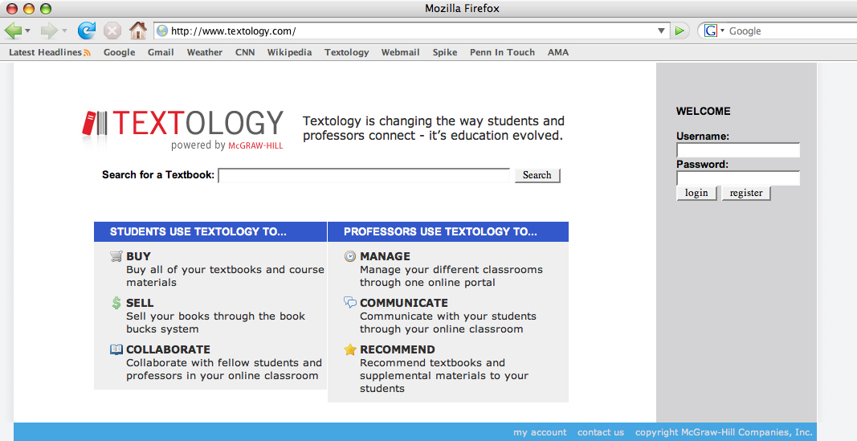

Slide 28
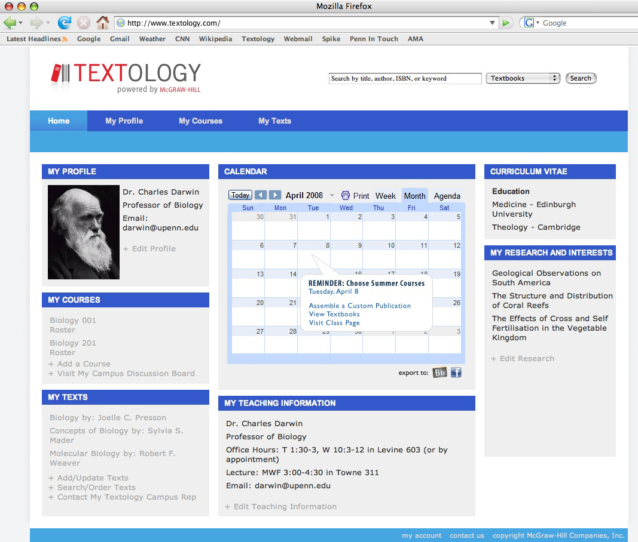
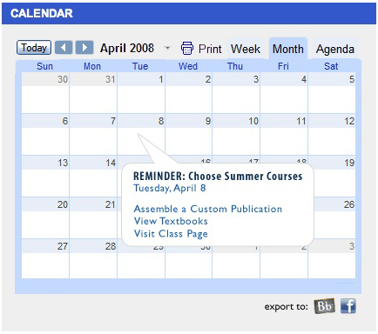

Slide 29
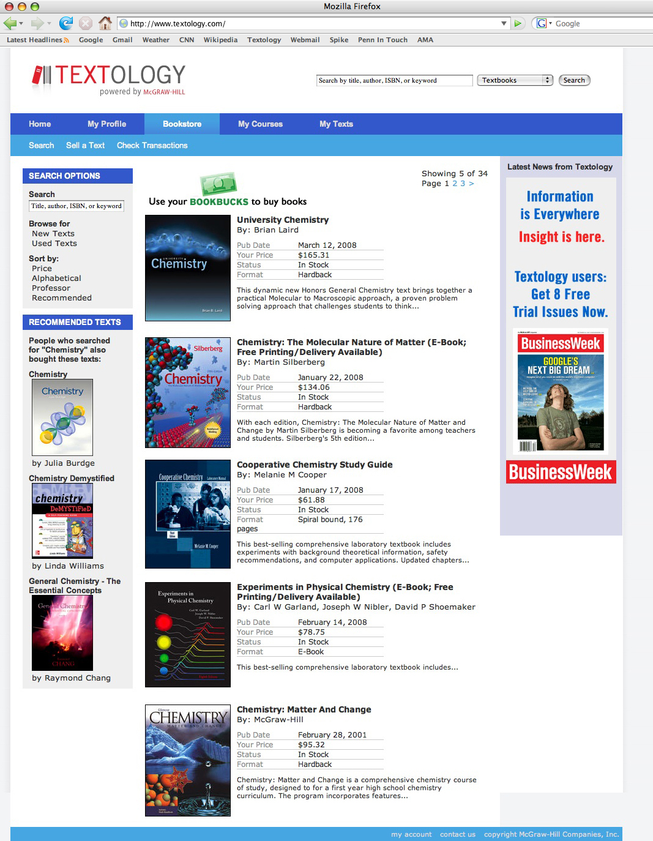
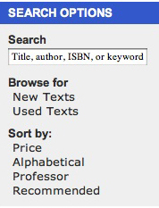
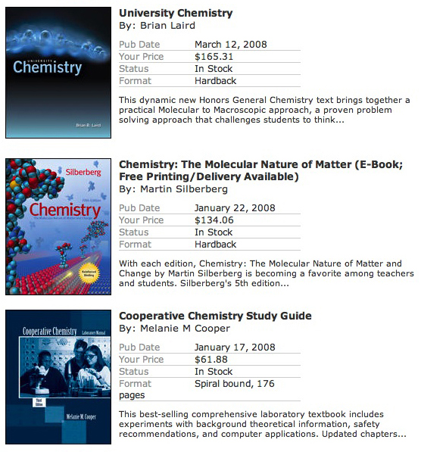
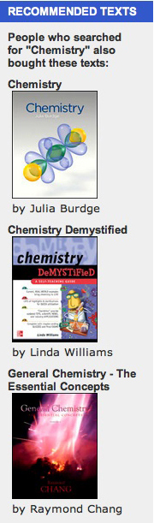

Slide 30
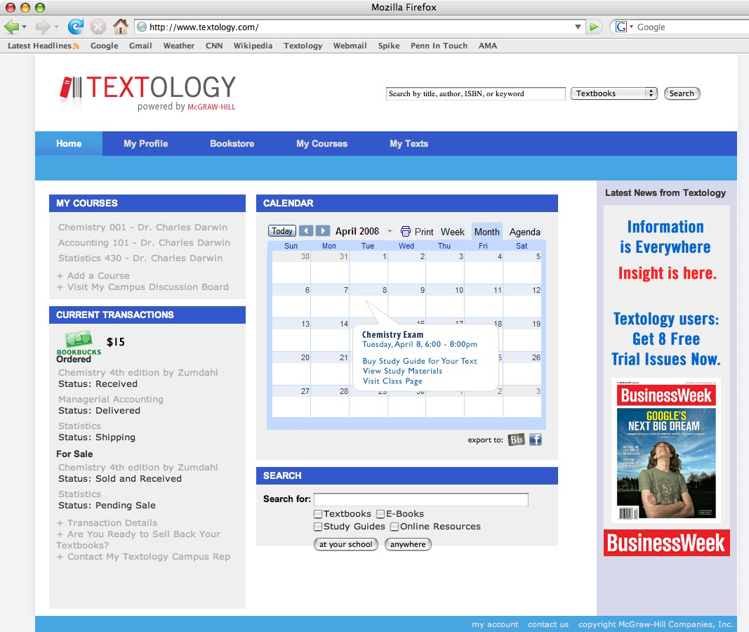
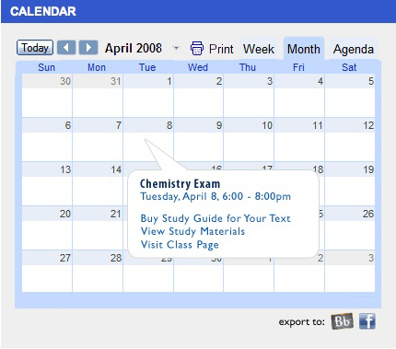

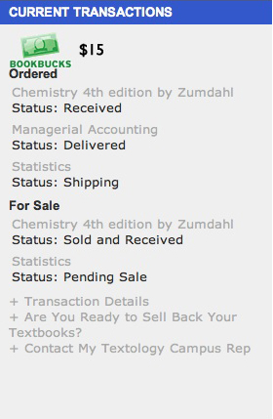

Slide 31
Performance Metrics
Track site effectiveness
Initial Outreach to Professors
5% first-year penetration for recommendation-based registration
Initial Launch to Students
250,000 total first-semester registration
8,000 daily unique visit with log-ins of once every two weeks
3% annual growth in new site users
60% repeat users carried over from first to second semester
Recurring Usage
Sustain usage past August/January peaks
3% first-year penetration among target users (usage)
Notes:
31

Slide 32
Developing the Portal
Marketing the Portal
Evolution
Analysis & Strategy

Slide 33
Positioning Statement
Reach professors and students with a unified message
To students and professors, Textology.com will be the leading destination for higher education materials and interactive resources that delivers:
Convenient communication channels
Supplementary content
Time and money-saving features
IMC
Notes:
33

Slide 34
The Portal Usage Script
Support each step in the usage decision with marketing tactics
Professor Acceptance and Usage
Student Awareness and Usage
Post Purchase Evaluation
Buzz and Positive Word-of-Mouth
McGraw-Hill Reps
“Evolve in No Time at All” Campaign
Student Reps
“Evolve” Campaign
“Join the Revolution” Campaign
“Survival of the Fittest” Campaign
Public Relations
IMC

Slide 35
The Professor Campaign
Emphasize time-saving benefits for professors
“Evolve in No Time at All” Campaign
  McGraw-Hill Sales Representatives
  Brochures
    Emphasizes features
  Emails of the Video Walkthrough
    Demonstrates the experience
  Giveaways
    Keeps the portal top-of-mind
Notes:
35

Slide 36
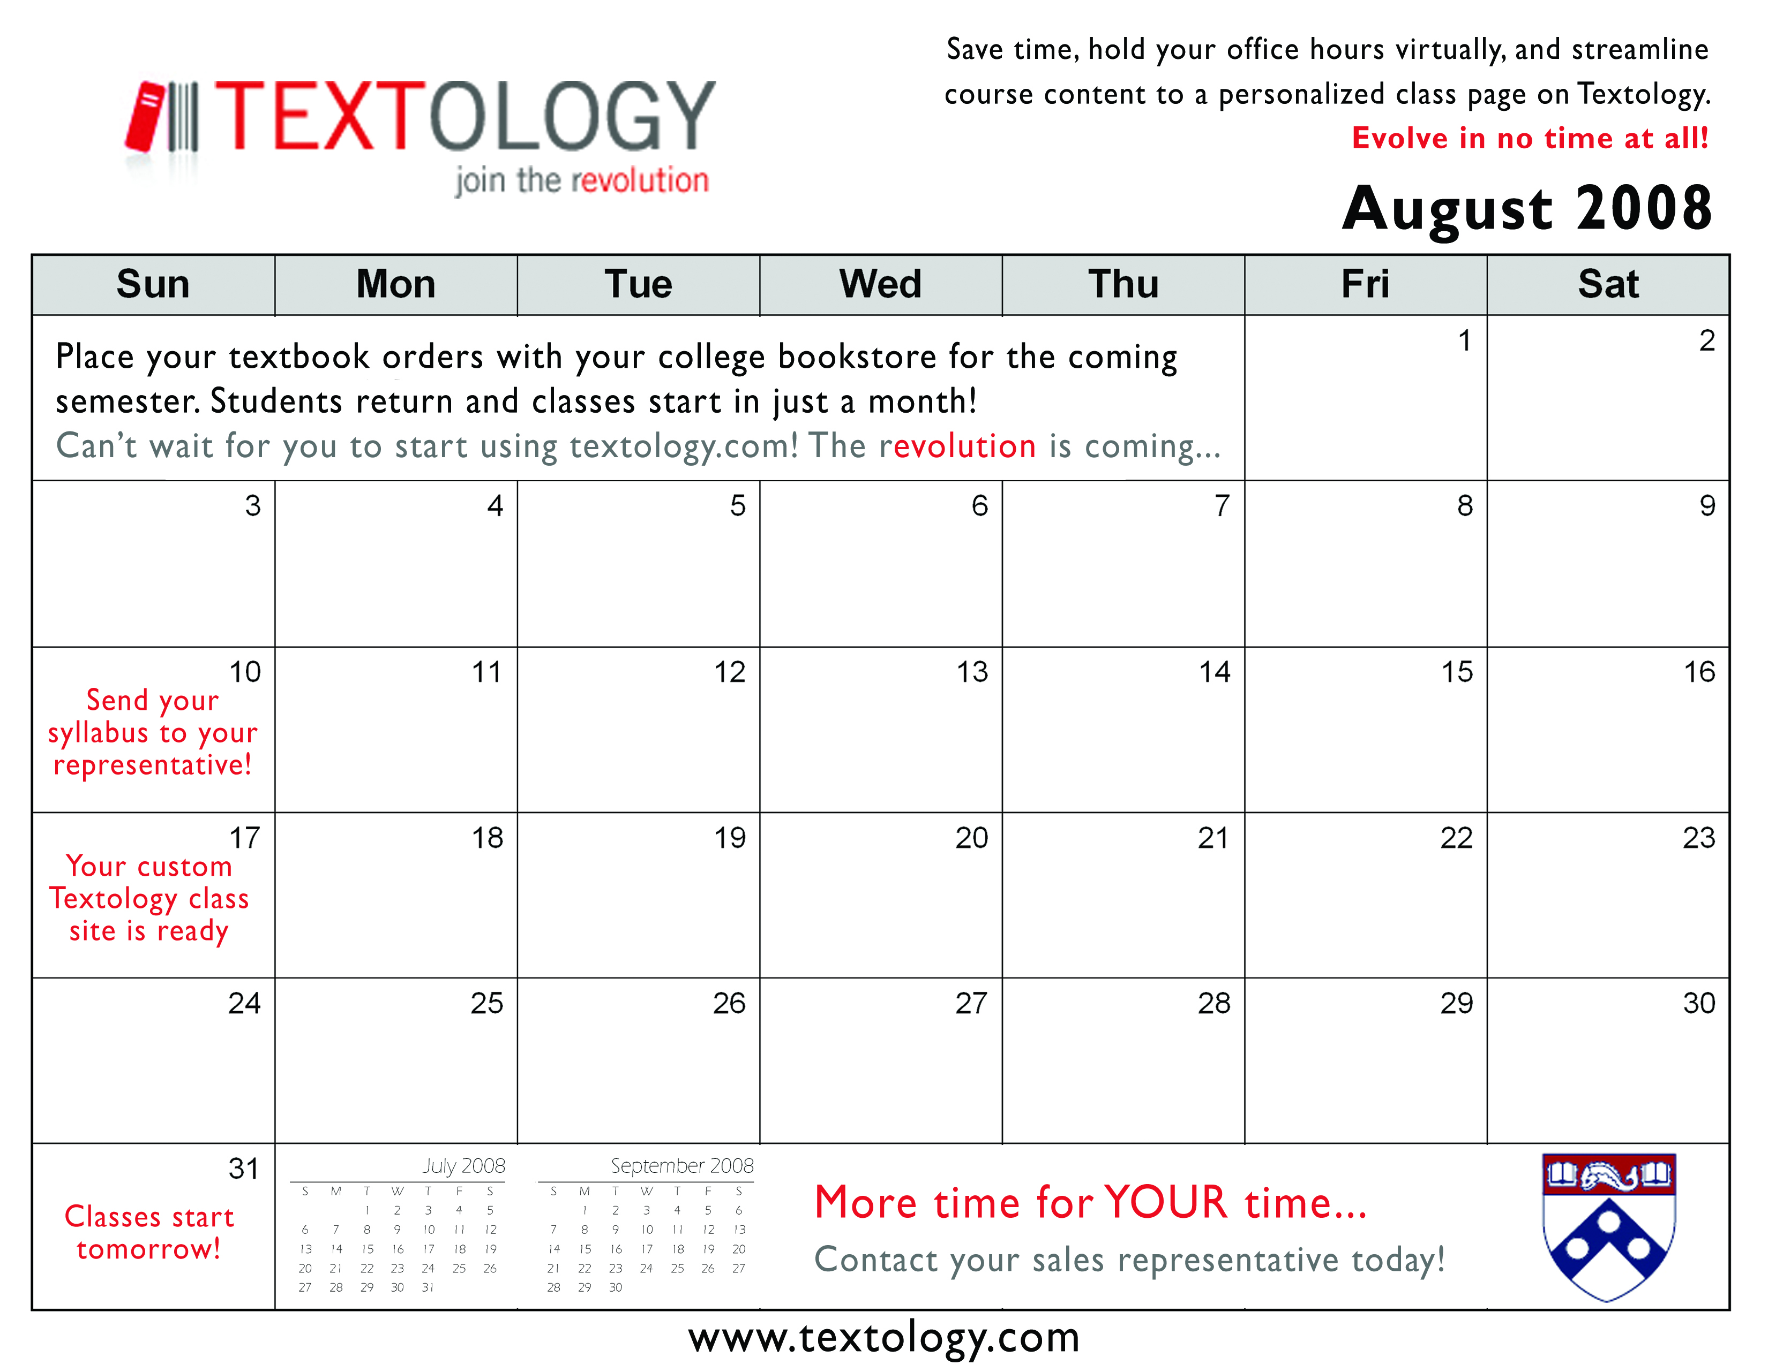

The Professor Calendar
Promote usage through constant reminders

Slide 37
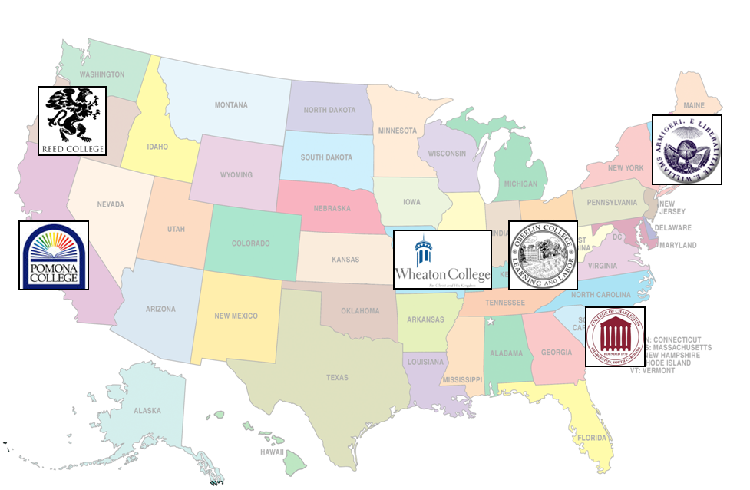
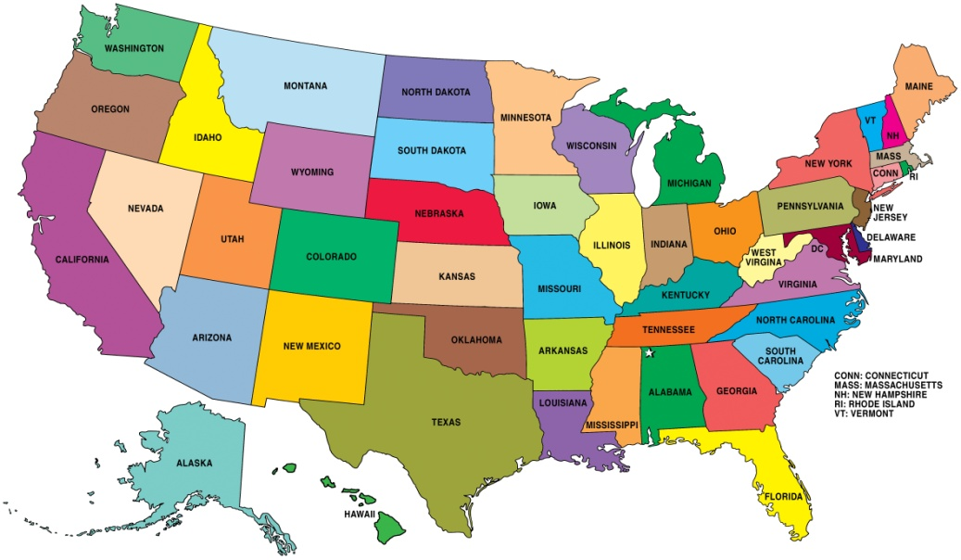










Targeting Schools
Roll out promotions at different schools
Dual approach
  Large research universities
    Large student populations
    Geographic diversity
    Spillover potential
  Smaller teaching schools
    Reach through student representatives
    Student-run events
Notes:
37

Slide 38
Campus Representatives
Use campus representatives to drive marketing campaign
Direct Marketing Strategy
  Event management
  Visibility on campus
Advantages
  Low cost
  School-specific knowledge
  Self-selecting pool
Notes:
38

Slide 39
The “Evolve” Campaign
Use on-campus events to drive usage at target schools
“Evolve” Tent Event
  Computer Display of the Site
  Wheel of BookBucks
  Wave of the Future
“Resolve” Promotion
  Drop 10 Pounds: Get an Ebook
“Involve” Charitable Event
Notes:
Maybe a bird’s eye view representation of events?
39

Slide 40


“Join the Revolution” Campaign
Use viral media to build awareness for a larger audience
Guerrilla Marketing
  Series of Evolution-themed viral videos
    MarketPlace
    StudyRoom
    Ebooks
Notes:
40

Slide 41
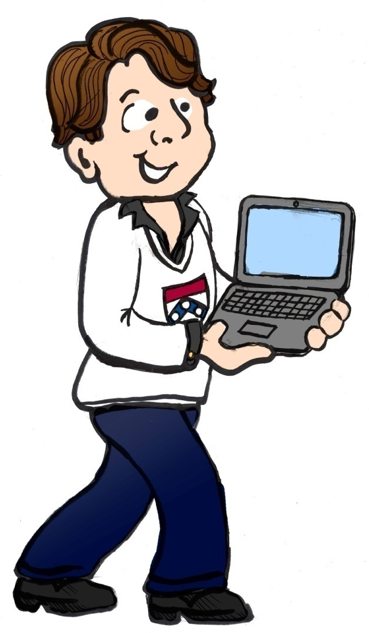

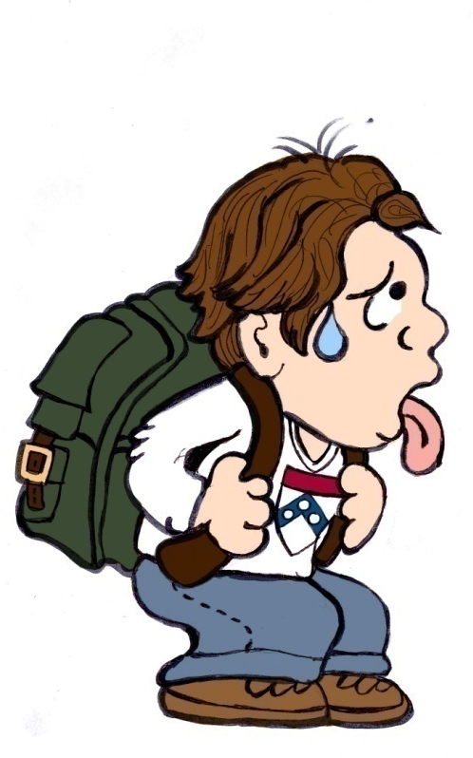

“Join the Revolution” Video Storyboard
Notes:
41

Slide 43
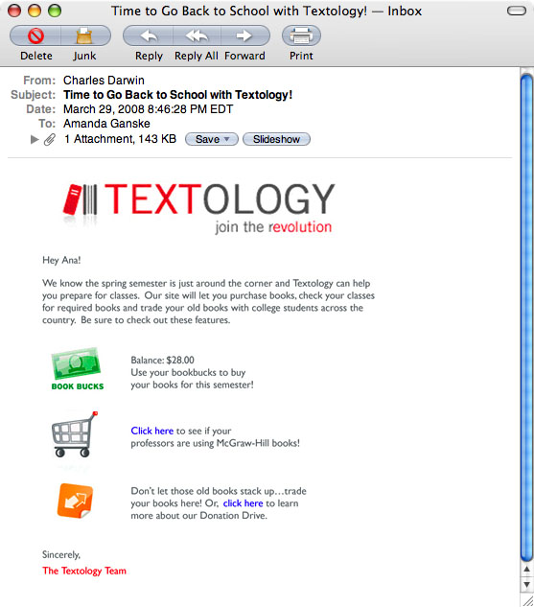

“Survival of the Fittest” Campaign
Periodically remind students about the portal to keep top-of-mind
Student calendars
Midterm study guide promotion
Email-reminders
Notes:
43

Slide 44


Word-of-Mouth
Use public relations to generate goodwill
“Involve” Charitable Event
  Donate used textbooks to Better World Books
BookBuck Donations
One Laptop per Child
Notes:
44

Slide 45
IMC Timeline
Launch events throughout the academic year to sustain interest
 |  |  | Fall Semester |  |  |  |  | Spring Semester
IMC Tactic | Jun | Jul | Aug | Sep | Oct | Nov | Dec | Jan | Feb | Mar | Apr | May
Sales Rep Training
Student Rep Hiring
Professor Campaign Launch
The "Evolve" Tent Event
Midterm Study Guide Promotion
The "Drop 10" Promotional Event
Textology Email
The "Involve" Charitable Event

Slide 46
Budget
Textology Marketing Campaign
Labor | $ 100, 000
StudyRoom | $ 60, 000
The Textology Tent | $ 107, 300
Charitable Event | $ 6, 000
Student Rep Events | $ 40, 000
Professor Giveaways | $ 5, 000
Online Marketing | $ 75, 400
Direct Marketing | $ 50, 000
Total Cost | $ 443, 700
Notes:
46

Slide 47
Partnerships and Outreach
Strategically expand the reach of Textology
FedEx/Kinko’s
  Ease ebook adoption
Blackboard
  Bring Textology to schools employing course software
Facebook.com
  Extend reach into students’ daily lives
Better World Books
  Make donations simple and control secondary market
Other Publishers
  Drive traffic by capitalizing on flexibility of Textology

Slide 48
Developing the Portal
Marketing the Portal
Analysis & Strategy
Evolution

Slide 49

Online Distribution
Textology enters the market with high traffic and credibility
SITE TRAFFIC
Student-run sites
PERCEIVED CREDIBILITY

Slide 50
Monetizing the Portal
Textology creates generous profits from multiple revenue streams

Slide 51
Addressing McGraw-Hill’s Concerns
McGRAW-HILL’S CONCERNS
OUR SOLUTIONS
Increasing internet usage has made used book sales easier
Gain control of the secondary market for profit and inventory management
Digital revolution has changed learning styles and materials across a variety of media
Consolidate online content and establish Textology as a complete digital learning resource
Implementing these changes and adapting to the evolving market effectively and profitably
Create relationships and switching costs with Textology; develop a variety of revenue streams
Notes:
- Concerns from case write-up
Increasing online sales of textbooks
Increasing digitization of learning content
51

Slide 52
Putting It All Together
Portal
Connect professors and students
Build relationships
IMC
Position Textology as the direct-to-student academic resource
EVOLUTION
Strategy
Be the missing link

